Slide 1
Lecture 3: Control Structures + Functions
Intro to Data Science for Public Policy
Spring 2017
Jeff Chen + Dan Hammer

Slide 2
Roadmap
Motivating Story
Control Structures
Functions
Code-along: Collaborative Filtering
Intro to Data Science for Public Policy, Spring 2017

Slide 3
Motivation
Oh, SNAP!
(Supplemental Nutrition Assistance Program
Or “Food Stamps”)
https://www.fns.usda.gov/snap/eligibility
Motivation
Notes:
SNAP is one of the most used safety net programs in the US, designed to provide Americans with the means to afford sustenance among those who cannot afford it.

Slide 4
Background
US Department of Agriculture (USDA) program
Original ‘Food Stamps Program’ established in 1939 and has evolved ever since. Peak participation at one time was 4 million.
Now mostly ‘Electronic Benefits Transfer’ (EBT)
FY2016
Benefits cost = $70.9 billion
User base = 44.2 million Americans
Motivation

Slide 5
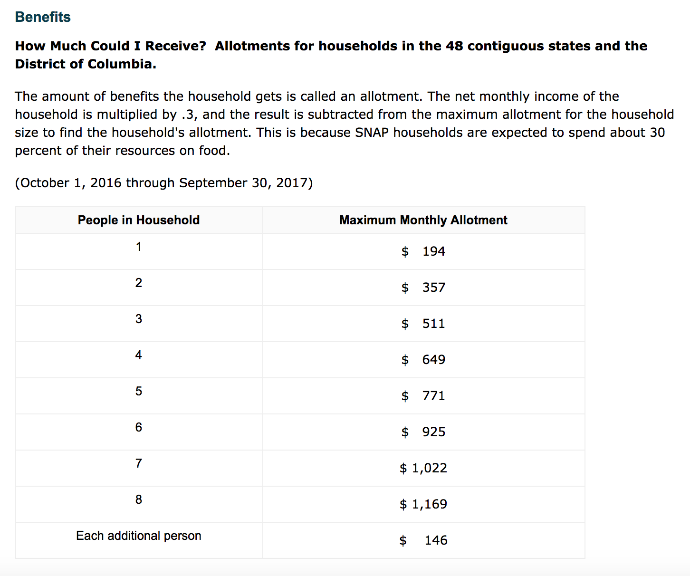
SNAP Benefits for FY2017
Motivation

Slide 6

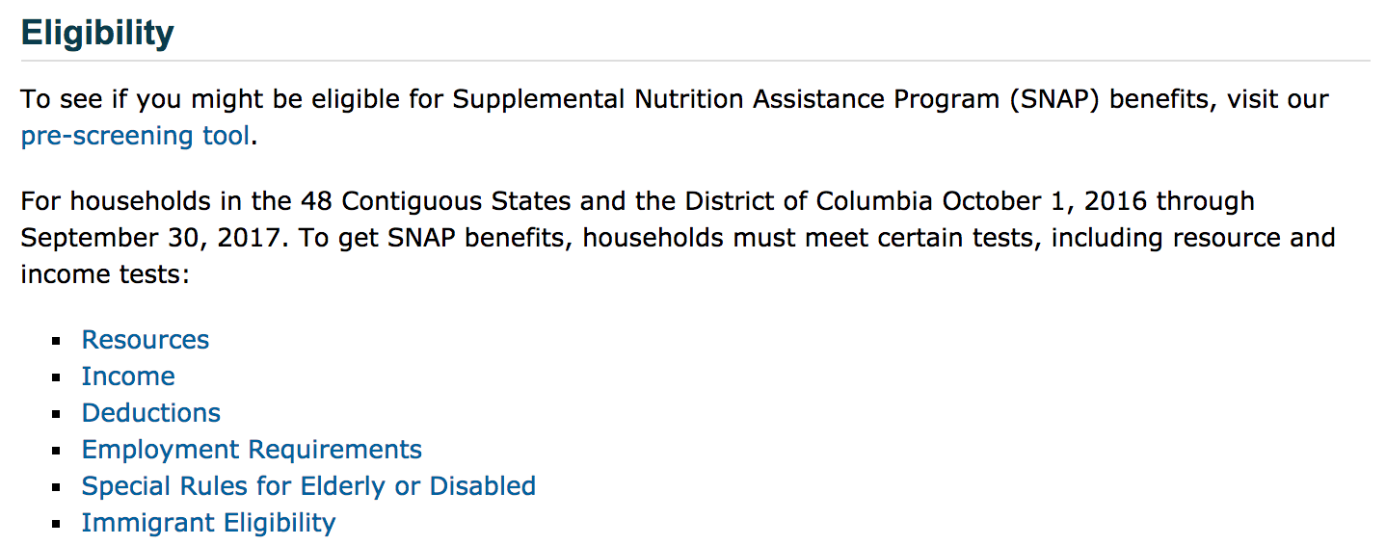
Motivation

Slide 7
Motivation

Slide 8
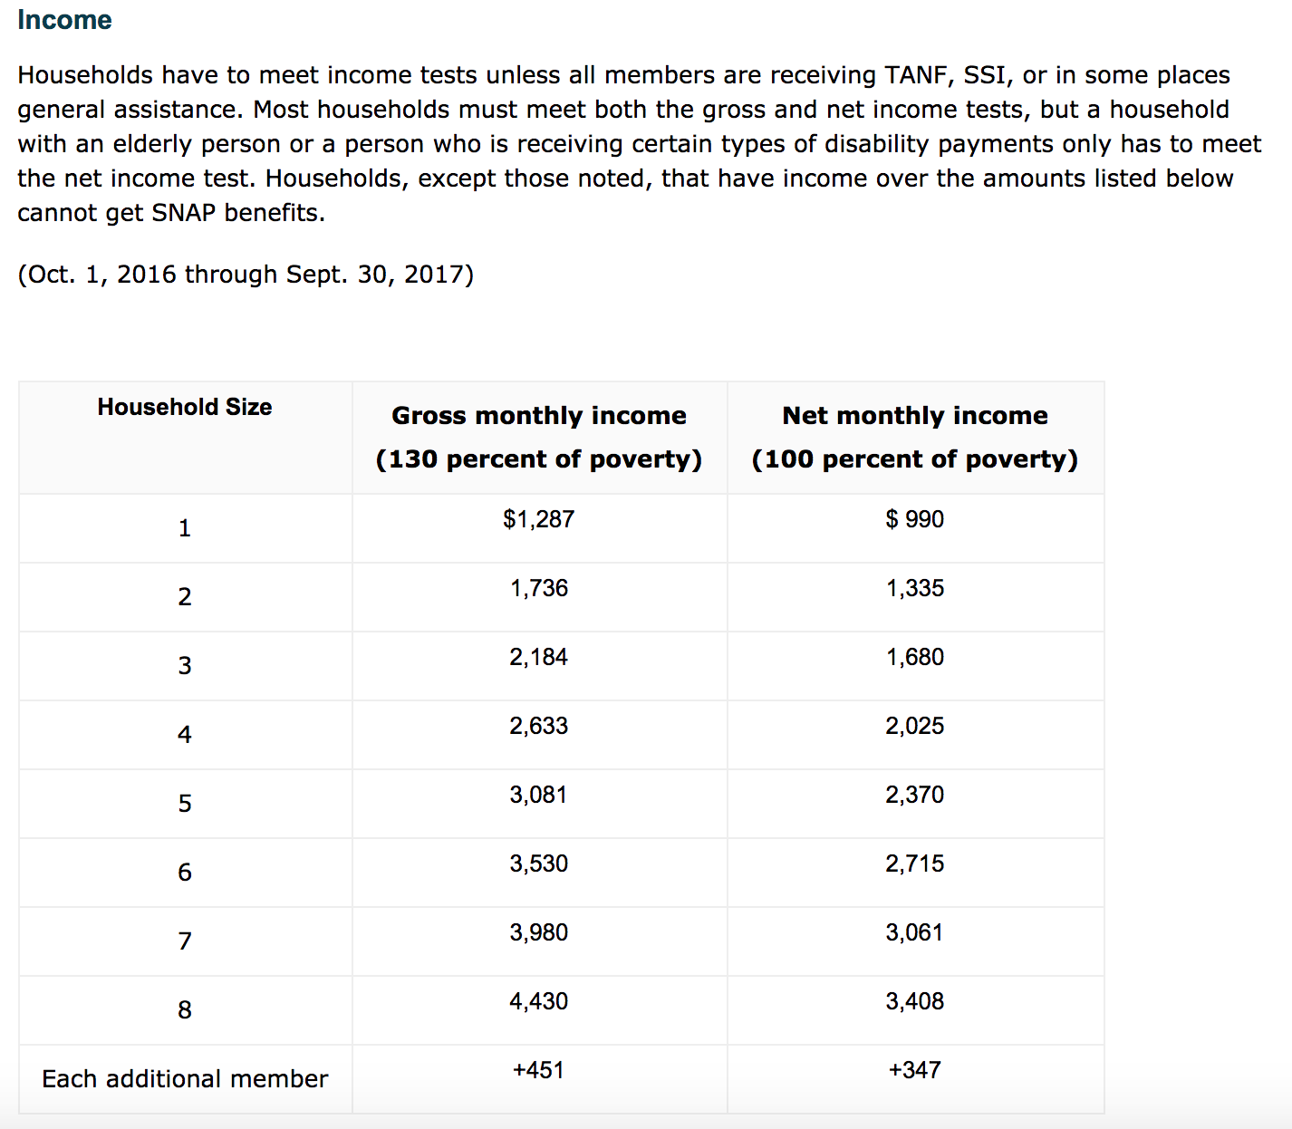
Motivation

Slide 9
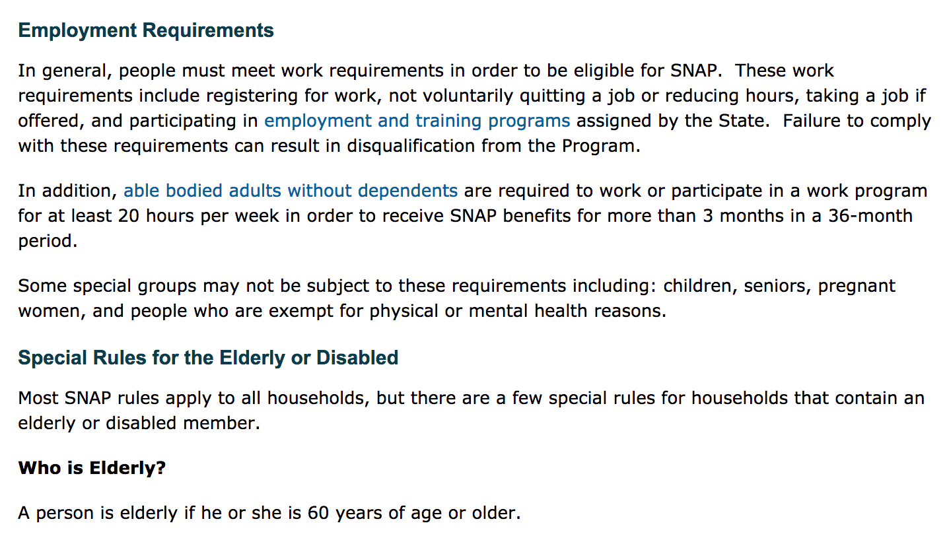
Motivation

Slide 10
Imagine if you had to figure that out manually for every applicant?!
Motivation

Slide 11
A Screening Process.
A decision tree, excluding employment requirement.
Start
Meets resource test
yes
no
All have TANF or SSI
Ineligible
yes
no
Eligible
Pass net income test
yes
no
Has elderly member?
Ineligible
yes
no
Eligible
Pass gross income test
yes
no
Eligible
Ineligible
Motivation

Slide 12
Start
Meets resource test
yes
no
All have TANF or SSI
Ineligible
yes
no
Eligible
Pass net income test
yes
no
Each decision point or “node” involves an argument that needs to be evaluated
Has elderly member?
Ineligible
yes
no
Eligible
Pass gross income test
yes
no
Eligible
Ineligible
Motivation

Slide 13
The procedures associated with the node can be codified into a series of pre-specified actions that converts an input into an output, or a function.
Function. Pass gross income test (Pseudo code)
INPUTS gross.income, family.size
TABLES ref
OUTPUT TRUE or FALSE
IF family.size <= 8,
a = FIND gross.income where ref.family.size == family.size
RETURN gross.income < a
ELSE
a = FIND gross.income where ref.family.size == 8
b = +347 x (family.size – 8)
RETURN gross.income < a + b
Motivation

Slide 14


What to do to screen a list of households?
Motivation

Slide 15
(1) Identify the minimum parameters
Resource = Amount in bank account, etc.
Welfare = List of other program participation
Net Income, Gross Income, Family Size
Elderly family member?
Employment status
Motivation

Slide 16
(2) Write discrete functions that handle each node if it requires any data manipulation.
Func. Meets resource test
Func. All have TANF or SSI
Func. Pass net income test
Func. Has elderly member?
Func. Pass gross income test
Motivation

Slide 17
(2) Write a master function that uses the short well-defined, discrete functions
Func. Meets resource test
Func. All have TANF or SSI
Func. Eligibility Tree Function
If( resources > resource.limit){
print("ineligible")
} else if(TANF | SSI){
...
Func. Pass net income test
Func. Has elderly member?
Func. Pass gross income test
Motivation

Slide 18
(3) Given a list of households and their attributes, apply function to each household, write out result.
Func. Eligibility Tree Function
Motivation

Slide 19
(3) Given a list of households and their attributes, apply function to each household, write out result.
Func. Eligibility Tree Function
Ineligible
Motivation

Slide 20
(3) Given a list of households and their attributes, apply function to each household, write out result.
Func. Eligibility Tree Function
Eligible
Motivation

Slide 21
(3) Given a list of households and their attributes, apply function to each household, write out result.
Func. Eligibility Tree Function
Eligible
Motivation

Slide 22
(3) Given a list of households and their attributes, apply function to each household, write out result.
Func. Eligibility Tree Function
Ineligible
Motivation

Slide 23
Roadmap
Motivating Story
Control Structures
Functions
Code-along
Intro to Data Science for Public Policy, Spring 2017

Slide 24
Control Structures
A set of code that analyzes input variables and controls the direction in which the code will flow.
Not all data should be treated the same. At times the idiosyncrasies dictate what actions should be taken.
Control structures operate on individual instances – “one at a time”
Control Structures

Slide 25
If-Else
Start
Control Structures
Meets resource test
yes
no
A record moves through a series of logical arguments
All have TANF or SSI
Ineligible
yes
no
Eligible
Pass net income test
yes
no
Has elderly member?
Ineligible
yes
no
Eligible
Pass gross income test
yes
no
Eligible
Ineligible
Control Structures

Slide 26
Start
If-else : example
Meets resource test
yes
no
All have TANF or SSI
Ineligible
yes
no
Eligible
Pass net income test
yes
no
Has elderly member?
Ineligible
yes
no
Eligible
Pass gross income test
yes
no
Eligible
Ineligible
Control Structures

Slide 27
If structure
One of the core control structures that evaluates a logical argument, then directs the ‘flow’ of the code.
The most basic formulation evaluates an argument. If true, then executes specific code.
Statement
if([statement]){
#do whatever is in here
}
TRUE
FALSE
Do something
Do nothing
Control Structures

Slide 28
If structure
earth <- "round"
if(earth == "round"){
print("The circumference is 24,901 miles!")
}
Control Structures

Slide 29
If-else structure
If-else adds an additional action for when the evaluated argument is FALSE.
Statement
if([statement]){
#Action 1
} else {
#Action 2
}
TRUE
FALSE
Action 1
Action 2
Control Structures

Slide 30
If-else structure
earth <- "cubed"
if(earth == "round"){
print("The Earth is a sphere!")
} else {
print("Check again, buddy.")
}
Control Structures

Slide 31
If-else structure
If-else can be greatly expanded to handle more complex scenarios
Statement
TRUE
FALSE
if([statement]){
#Action 1
} else if([another statement]){
#Action 2
} else {
#Action 3
}
Action 1
Statement 2
TRUE
FALSE
Action 2
Action 3
Control Structures

Slide 32
If-else structure
earth <- "ball"
if(earth == "sphere"){
print("Indeed, the earth is a sphere!")
} else if(earth == "ball"){
print("There’s a better word for that. ")
} else {
print("Nope.")
}
Control Structures

Slide 33
Nested if-else
exercise
Write the if-else code to print the values in red
x > 5
FALSE
TRUE
x > 10
x < 0
TRUE
FALSE
TRUE
FALSE
x < -10
0 <= x <= 5
x > 10
5 < x <=10
TRUE
FALSE
x < 10
-10 <= x < 0
Control Structures

Slide 34
If-else structure: exercise
if(x > 5){
if(x > 10){
print("x > 10")
} else {
print("5 < x <= 10")
}
} else {
if(x < 0 ){
if(x < - 10){
print("x < -10")}
else {
print("-10 <= x <= 0")
} else {
print("0 <= x <= 5")
}
}
Control Structures

Slide 35
The function is applied a specified number of times (i) and returns a result for each of the i iterations
For Loops
Control Structures
ScreeningFunction
Apply to all 12 people
Control Structures

Slide 36
The function is applied a specified number of times (i) and returns a result for each of the i iterations
For Loops: example
Screening Function
STOP
1 2 3 4 5 6 7 8 9 10 11 12
Control Structures

Slide 37
For-loop construction
For a given range of values, for-loops will iterate through each value in the range. In each iteration, the index variable “i” is replaced with the next sequential value in the range.
for(i in 1:10){
print(i)
}
vec <- c("CA", "VA", "NY")
for(i in vec){
print(i)
}
Control Structures

Slide 38
For-loops: Under the hood
(2) i is the “index”. When initiated, the first value of i = 1, then after print(i) is run, the next value will be 2.
(1) The loop will iterate through all numbers from 1 through 10
for(i in 1:10){
print(i)
}
(3) The print statement will execute whenever the value of i is changed.
Control Structures

Slide 39
For-loops: Loop the loop
What if there are multiple dimensions that need to be looped? Nested loops allow for more complex operations.
#Nested loops
for(i in 1:10){
for(j in 10:1){
print(paste(j, i))
}
}
Notice the change in the indices.
Why is this important?
Control Structures

Slide 40
For-loops: programming paradigms
For-loops are often used to compute and transform data into new results for each record of a dataset.
Create dummy, then append. The data needs to be stored. Thus, often times, a ”dummy” object needs to be created before entering into the loop. Then values are added to that object.
Create dummy, then overwrite. Similar to above, create a dummy object, but specifying the dimensions of the object, then rewrite individual cells. This is useful for large datasets.
Control Structures

Slide 41
For-loops: programming paradigm
#Dummy --> append
#add data to empty vector
x <- c()
for(i in 1:10){
x <- c(x, runif(i))
}
x
length(x)
#Dummy → Overwrite
#set matrix size, over
x <- matrix(NA, nrow = 100,
ncol = 100, byrow= T)
for(i in 1:nrow(x)){
for(j in 1:ncol(x)){
x[i,j] <- runif(1)
print(paste(i, j))
}
}
x
length(x)
Control Structures

Slide 42
For-loops: tips
for(i in 1:10){
print(i)
}
Use print() to help log where you are in your loop. It’s standard to place the index value i in the statement
Consider using proc.time() to time your loops to get a sense of performance.
Write the contents of your loop first before trying to put into the loop. Test it on a few cases to see if it works.
a <- proc.time()[3]
for(i in 1:10){
print(i)
}
proc.time()[3] - b
Control Structures

Slide 43
For-loops: exercise
Fibonacci numbers are defined as
Fn = Fn-1 + Fn-2
or numbers that are defined as the sum of the preceding two numbers. For example, given an initial sequence of “0, 1”, the next five numbers are “1, 2, 3, 5”. Write a forloop to get the 100th Fibonacci number.
Control Structures

Slide 44
For-loops: exercise
n0 <- 0
n1 <- 1
f <- 0
for(i in 1:99){
f <- n0 + n1
n0 <- n1
n1 <- f
}
option(scipen=999)
f
Answer: 354224848179261915075
Control Structures

Slide 45
While Loops
A function is applied until a criteria is no longer met.
Control Structures
ScreeningFunction
Find the Golden Child
Control Structures

Slide 46
A function is applied until a criteria is met.
While loops: example
Screening Function
Find the Golden Child
STOP
Control Structures

Slide 47
While loop construction
Given a logical statement, while loops continue to iterate so as long as the logical statement is TRUE
Often times, an index value needs to be advanced within the loop
temp <- 0
while(temp < 100){
print(paste("It’s ", temp,"F, still cool"))
temp <- temp + 2
}
print("Too hot now.")
Control Structures

Slide 48
While loop construction: exercise
Given the function f(x) = 1/x, at what value of x does the percent change between xi and xi-1 fall below 0.03%? Assume the function’s lower bound is x=2.
Control Structures

Slide 49
While loop construction
x <- 2
delta <- 1
while(delta > 0.003){
f0 <- 1/(x-1)
f1 <- 1/x
delta <- abs(f1/f0 - 1)
x <- x + 1
}
x-1
Control Structures

Slide 50
Roadmap
Motivating Story
Control Structures
Functions
Code-along
Intro to Data Science for Public Policy, Spring 2017

Slide 51
Functions
Intro
User-defined functions are a set of code that accept an input, work in sequence to produce a result. Functions operate with specific parameters, much like the mean() and gsub() and methods.
func <- function(param1, param2,...){
statements
return(obj)
}
Functions

Slide 52
Functions
Intro
Why write your own function?
More efficiently process and handle data on an ongoing basis (e.g. automate analyses, visualizations, data cleansing)
Create new algorithms for prediction and research
Write new libraries to do higher level tasks (example: ggplot2 came from somewhere!)
Functions

Slide 53

Function example
$$cov(X,Y)= \frac{1}{n}\sum_{i=1}^{n}{(x_{i}−\overline{x})(y_{i}−\overline{y})}$$
Example: Sample Covariance =
#Create data
set.seed(123)
x <- rnorm(100,10,3)
y <- rnorm(100,50,4)
Functions

Slide 54
Function example
$$cov(X,Y)= \frac{1}{n}\sum_{i=1}^{n}{(x_{i}−\overline{x})(y_{i}−\overline{y})}$$
Example: Sample Covariance =
#The real COV
cov(x, y)
#Function
cov2 <- function(x, y){
z <- sum((x - mean(x)) * (y - mean(y))) / (length(x)-1)
return(z)
}
#Check
cov2(x, y)
Functions

Slide 55
Function: exercise
Convert the Fibonacci sequence into a function fibseq() with parameters n0, n1, and high (nth number)
n0 <- 0
n1 <- 1
f <- 0
for(i in 1:99){
f <- n0 + n1
n0 <- n1
n1 <- f
}
Functions

Slide 56
Function: exercise
fibseq <- function(n0, n1, high){
f <- 0
for(i in 1:(high - 1)){
f <- n0 + n1
n0 <- n1
n1 <- f
}
return(f)
}
Functions

Slide 57
Roadmap
Motivating Story
Control Structures
Functions
Code-along: Collaborative Filtering
Intro to Data Science for Public Policy, Spring 2017

Slide 58
Collaborative Filtering
Recommendation engines are one of the most used tools to upsell products. Orgs that use rec engines:
Netflix
Amazon
Ebay
Google
Dating services
Pandora/Spotify
Any organization with many products and repeat could benefit from a rec engine
Codealong

Slide 59
Collaborative Filtering
Recommendation engines often times are driven by preferences as revealed by users on websites:
Views
Likes
Purchases
Ratings
Codealong

Slide 60
Collaborative Filtering
People with similar purchasing behaviors are more likely to accept product recommendations.
Person | Syringes | Alcohol pads | Bandaids | Insulin | Neosporin
Jake | 1 |  |  | 1
Amy | 1 | 1 |  | 1
Oliver |  | 1 | 1
Sally |  | 1 | 1 |  | 1
Codealong

Slide 61
Collaborative Filtering
Jake and Amy both purchase insulin and syringes. Since Amy purchased alcohol pads, Jake might also need alcohol pads.
Person | Syringes | Alcohol pads | Bandaids | Insulin | Neosporin
Jake | 1 |  |  | 1
Amy | 1 | 1 |  | 1
Oliver |  | 1 | 1
Sally |  | 1 | 1 |  | 1
Codealong

Slide 62
Collaborative Filtering
If someone buys Neosporin, what item should be recommended? The result is intuitive and can be quantified
Person | Syringes | Alcohol pads | Bandaids | Insulin | Neosporin
Jake | 1 |  |  | 1
Amy | 1 | 1 |  | 1
Oliver |  | 1 | 1
Sally |  | 1 | 1 |  | 1
Codealong

Slide 63

Collaborative Filtering
Cosine similarity measures the angle between two non-zero vectors. Pearson’s Correlation is the mean-centered version.
$$\cos\left(θ\right)= \frac{\sum_{i=1}^{n}{X_{i}Y_{i}}}{\sqrt{\sum_{i=1}^{n}{X_{i}^{2}}}\sqrt{\sum_{i=1}^{n}{Y_{i}^{2}}}}$$
Where X and Y are binary vectors. When binary data, cosine similarity is bound between 0 and 1, where 0 is no correlation
Codealong

Slide 64
Collaborative Filtering
Item-based filtering requires a n x n cosine similarity matrix that allows for ranking similarly purchased items.
 | Syringe | Alcohol pad | Bandaid | insulin | neo
syringe | 1.00 | 0.41 | 0.00 | 1.00 | 0.00
alc | 0.41 | 1.00 | 0.82 | 0.41 | 0.58
band | 0.00 | 0.82 | 1.00 | 0.00 | 0.71
insul | 1.00 | 0.41 | 0.00 | 1.00 | 0.00
neo | 0.00 | 0.58 | 0.71 | 0.00 | 1.00
Codealong

Slide 65
Collaborative Filtering
If someone buys a Bandaid, which item(s) should be paired?
 | Syringe | Alcohol pad | Bandaid | insulin | neo
syringe | 1.00 | 0.41 | 0.00 | 1.00 | 0.00
alc | 0.41 | 1.00 | 0.82 | 0.41 | 0.58
band | 0.00 | 0.82 | 1.00 | 0.00 | 0.71
insul | 1.00 | 0.41 | 0.00 | 1.00 | 0.00
neo | 0.00 | 0.58 | 0.71 | 0.00 | 1.00
Codealong

Slide 66
Collaborative Filtering: Public Policy Use
Call centers can be automatically fed types of products and alerts to callers when certain services are requested
Medical centers and social services can provide recommendations of other services
Codealong

Slide 67
Collaborative Filtering: Considerations
Types of measures: Ratings, views, purchases
Dependent on user base: wisdom of the crowds good if people have similar behavior, but pockets of atypical users skew results
Sparsity: More items higher chance of many blanks.
Computation: For large number of items, computation will take a while.
Codealong full example: 1900 x 17900 matrix requires 4 hours.
Codealong 1900 x 500 item example: < 1 min.
Codealong

Slide 68
For next time
Read Lecture 4 – Exploratory Data Analysis
Homework #1 due before Lecture 4 starts
Codealong

